Slide 1
Implementing Effective Logging

Slide 2
Not very exciting…
Ugh, logging
Later…
Replication
How do you use your application logs?

Slide 3
Basics…
Terminal > Root of App > Type “npm run dev”
nodemon
morgan
Web logs
Mongo logs
stdout

Slide 4
Intermediate…
What is useful to a tester to log?
Create a bespoke morgan format using morgan docs
Negative tests for user management

Slide 5
Targeting…
Creating a unique id
Tracing in distributed systems
Add to our web logging
Generate a unique id

Slide 6
Structured Logging
Readability for machines
Tools can assist your testing
Manual searches of log files are fallible
Grep is good, but not enough

Slide 7
Structured Logging
Logging structured data to console
Mongo
Web
Add some user journey tests

Slide 8
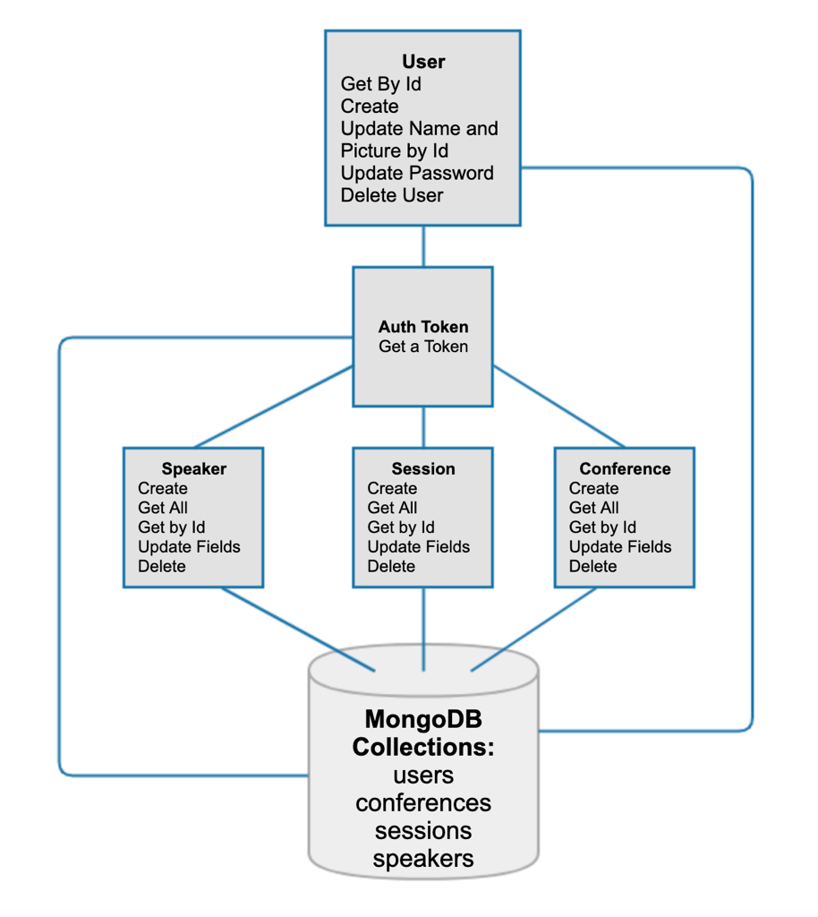
Where’s the risk?
What could go wrong?
How can logging help us?

Slide 9
Event Identifiers
Clear, consistent naming
Alerting on failure
Alerting on deployment
Metrics on usage

Slide 10
Diagnostic Events
Application start up
Initial database connection
Database connection errors
Trigger the error…

Slide 11
Business Events
Add an eventLookup
Successful user creation
Unsuccessful user creation
What could a tester use these for?

Slide 12
Ready for a break?

